Slide 1

Articoli da ricordare nel 2024-2025
BEST PAPERS IN CHIRURGIA D’URGENZA
Mauro podda
dipartimento di scienze chirurgiche
Università degli studi di cagliari

Slide 2
COI DISCLOSURE
Nessun conflitto di interessi da dichiarare in merito a questa relazione

Slide 3
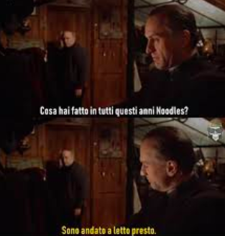
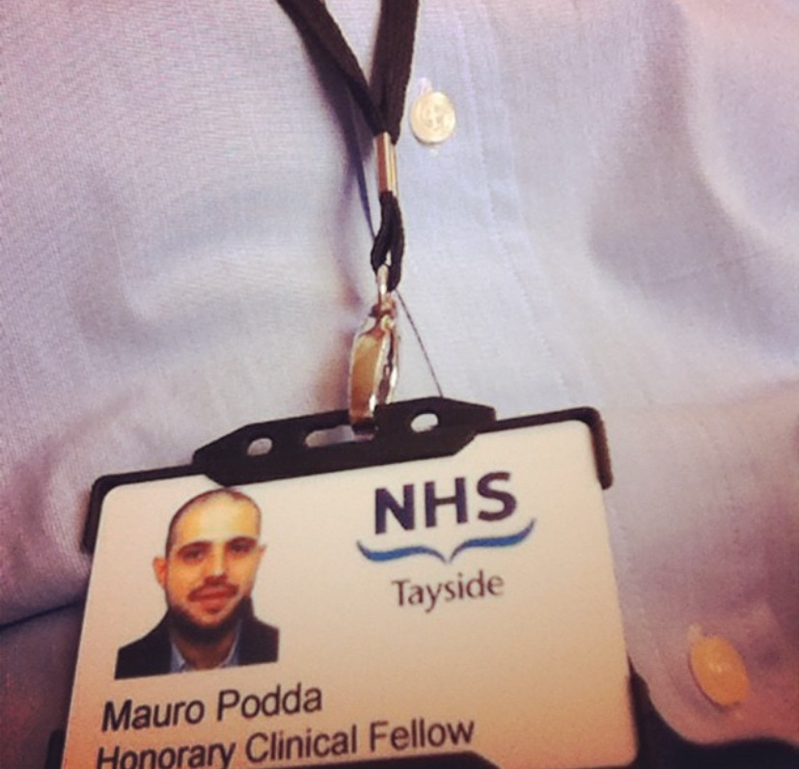
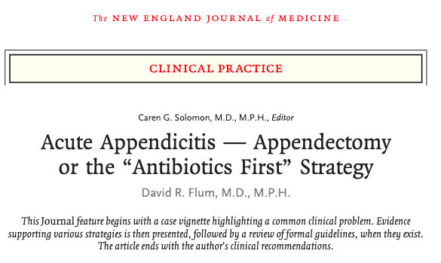
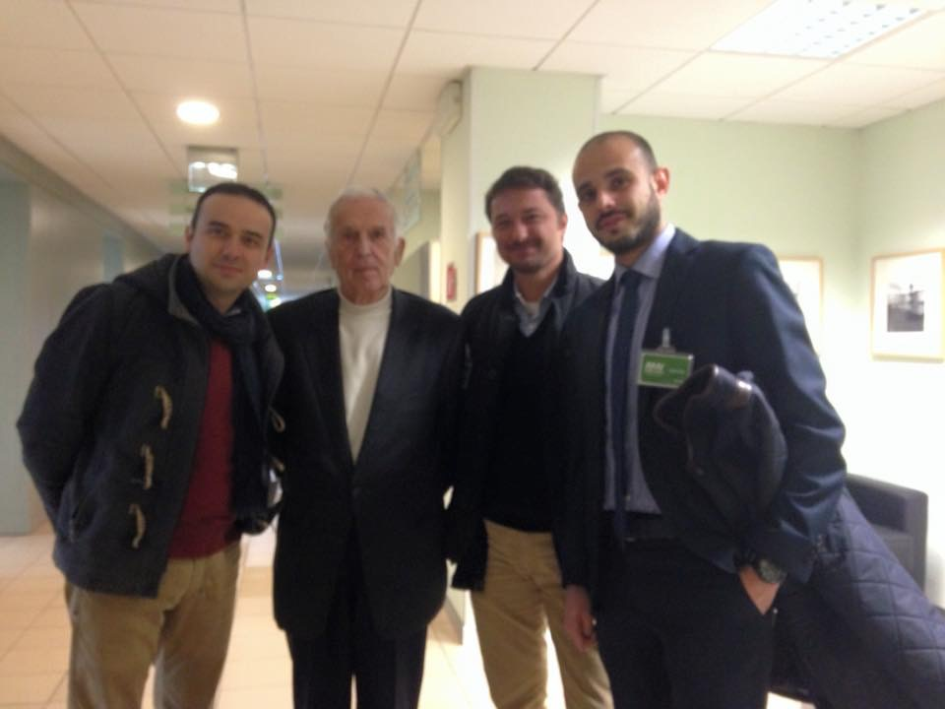
Tuttavia...

Slide 4
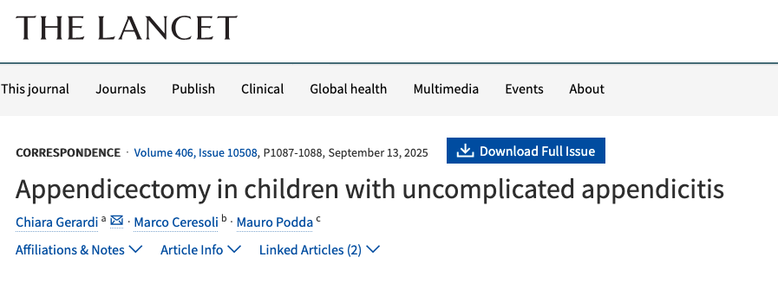
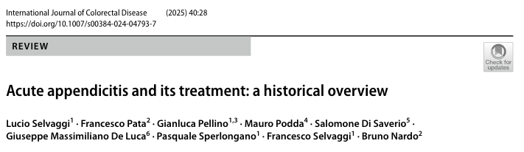
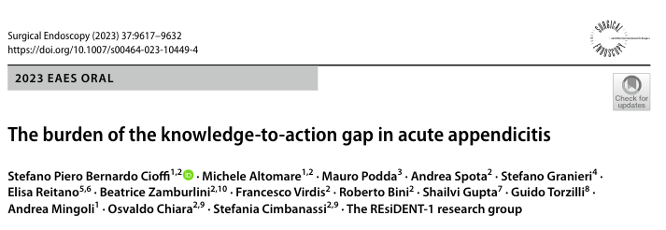
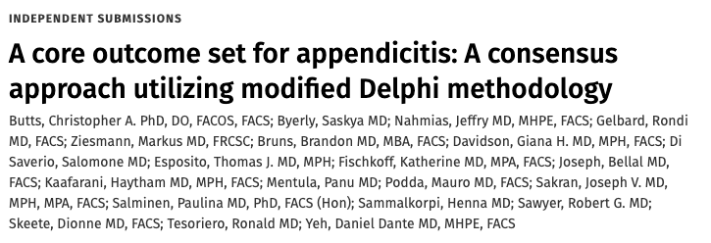
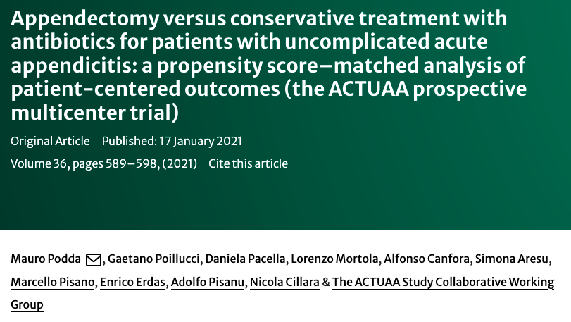
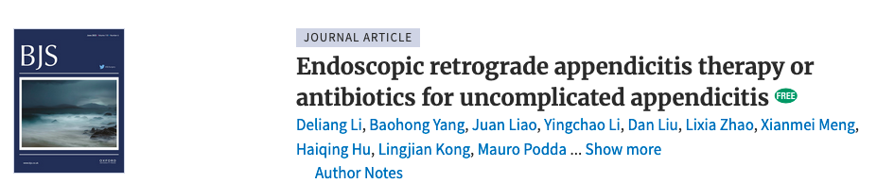
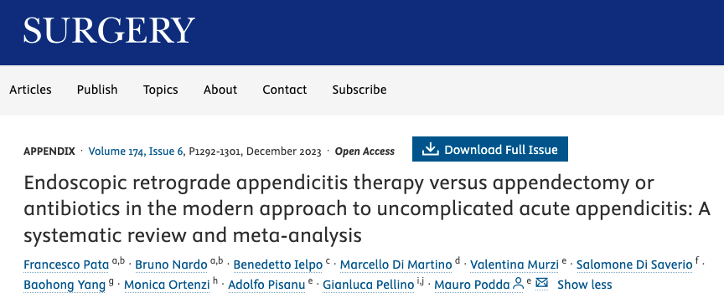
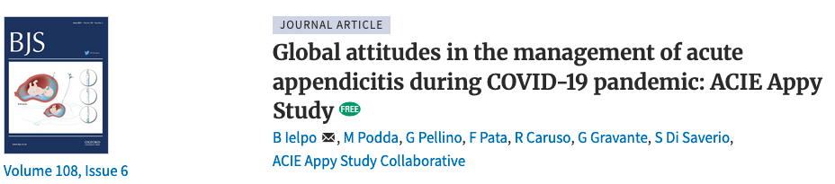

Slide 5
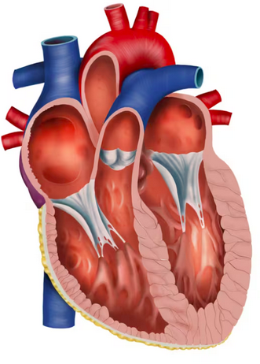
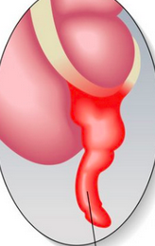

Slide 6

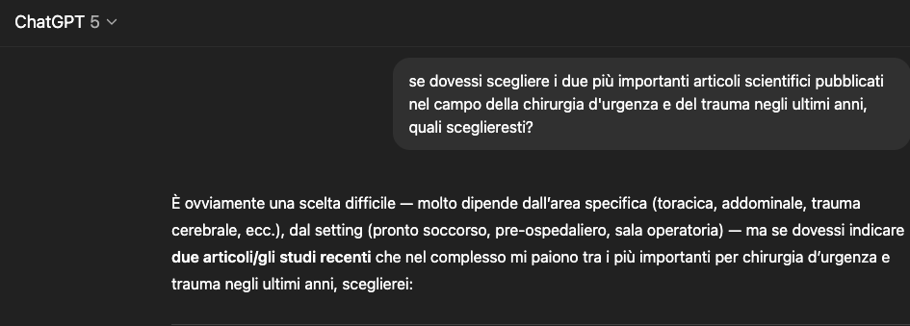

Fenton
(eroe nazionale britannico)

Slide 7







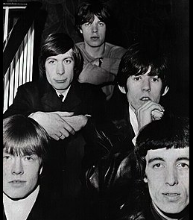

Slide 8
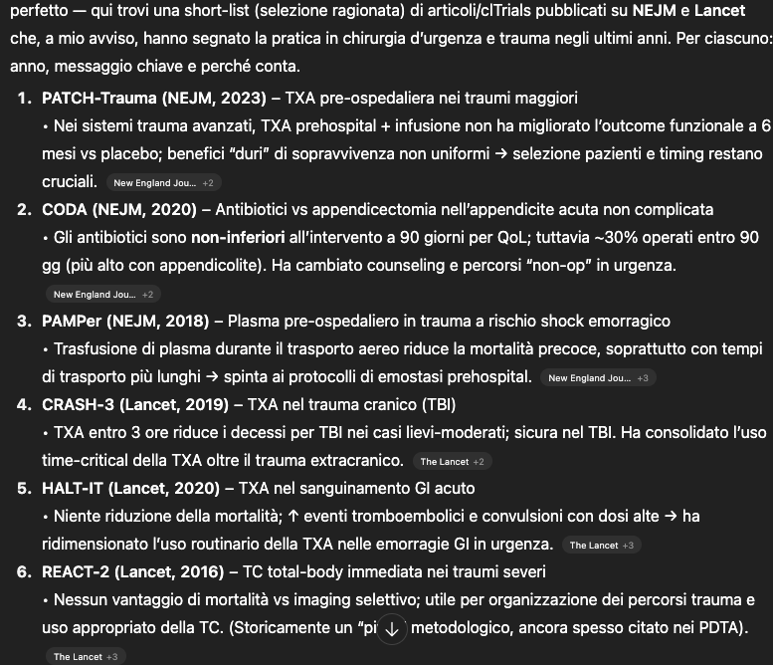
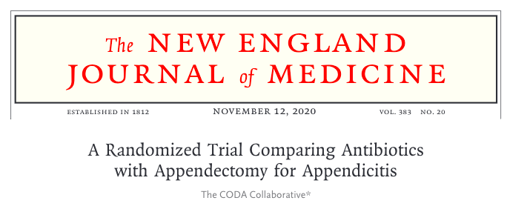

Slide 9
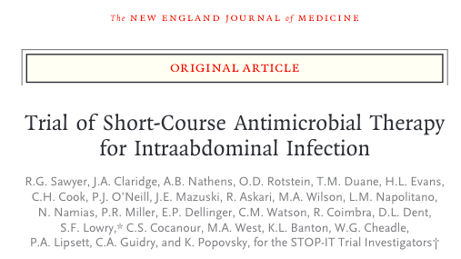
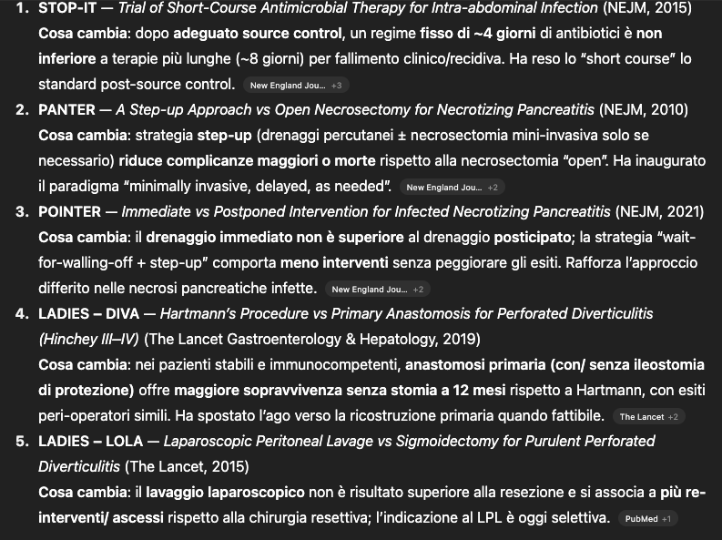
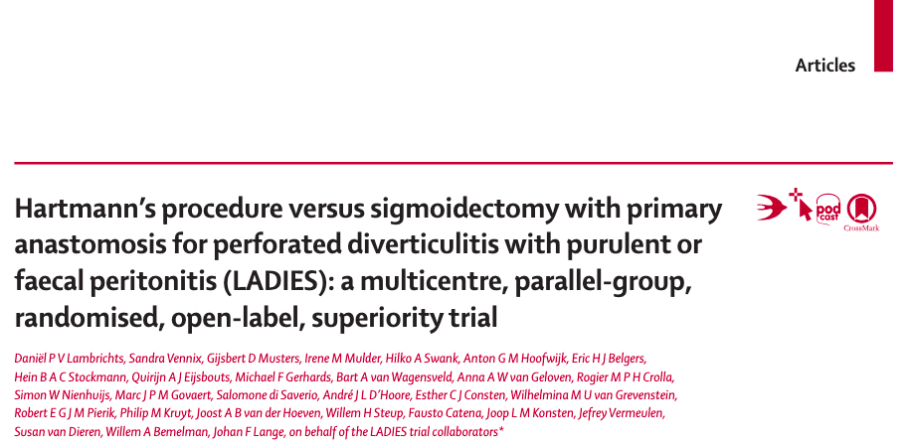
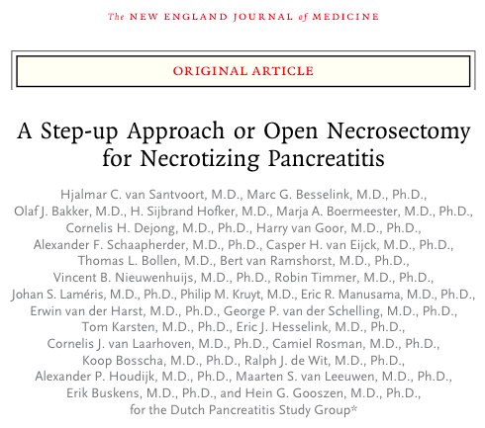
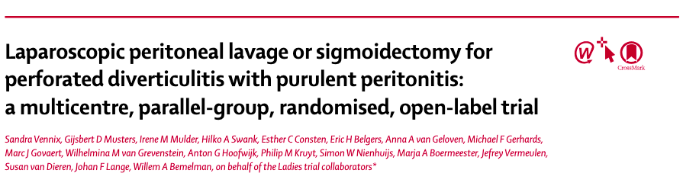
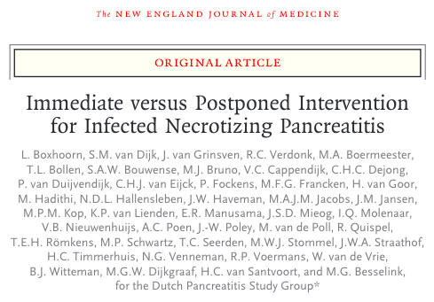
STOP-IT trial 2015
LADIES-DIVA 2019
PANTER 2010
LADIES-LOLA 2015
POINTER 2021

Slide 10
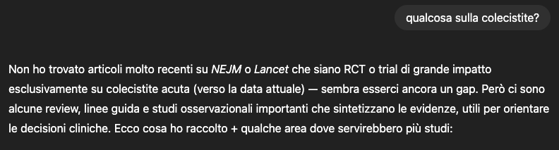
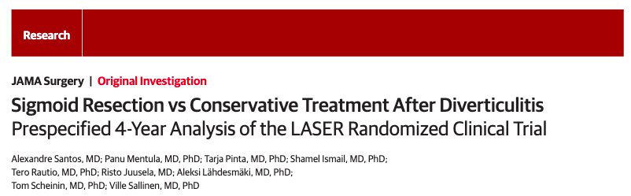
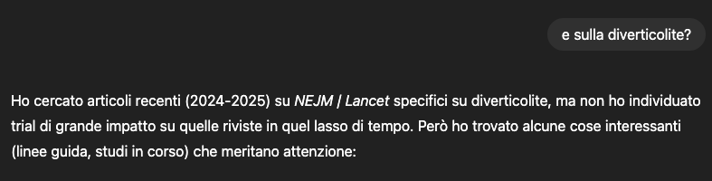
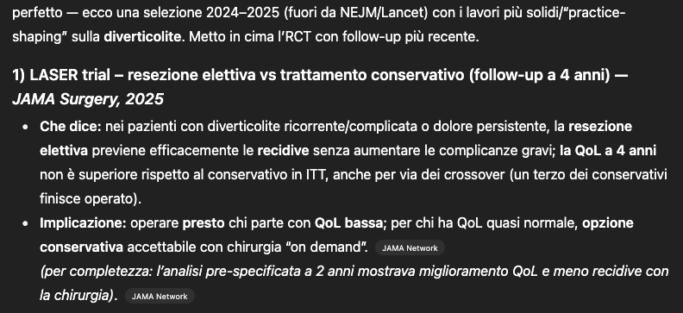
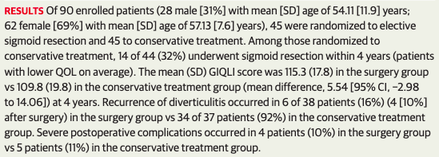
3 or more episodes of left colon diverticulitis within a 2-year period with at least 1 episode verified using computed tomography (CT)
1 or more episodes of complicated left colonic diverticulitis treated conservatively
prolonged pain or disturbance in bowel habits over 3 months
after an episode of CT-verified acute left colonic diverticulitis.

Slide 11
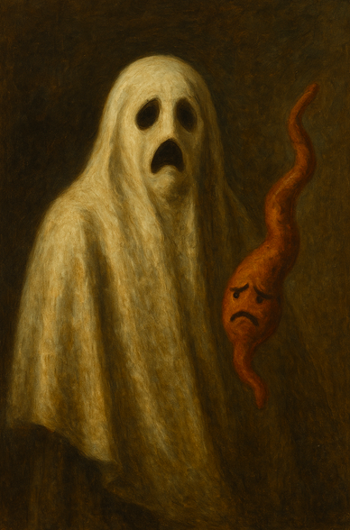
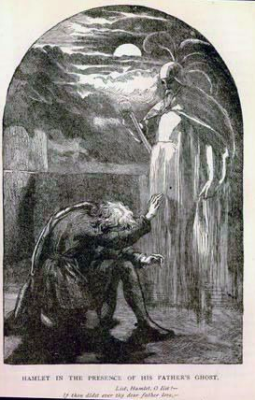

Slide 12
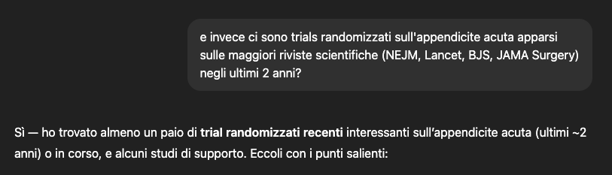
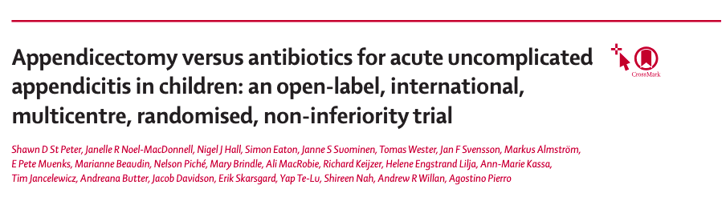
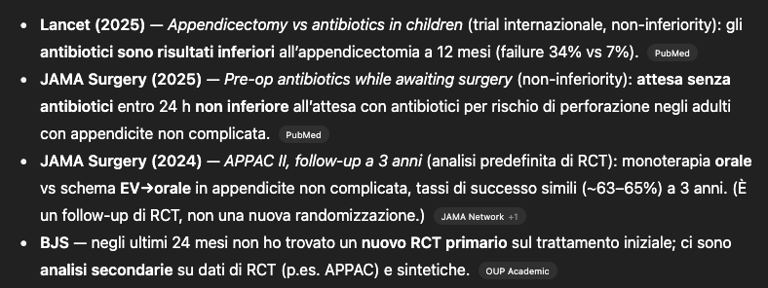
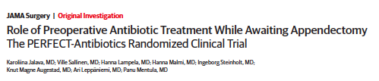
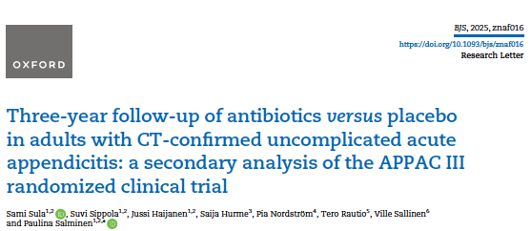

Slide 13
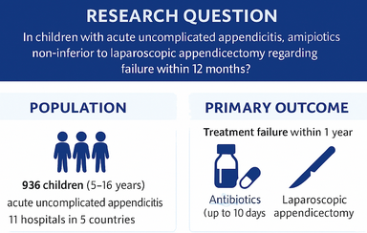
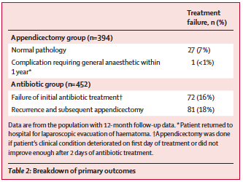

FAILURES
Antibiotics: 34%
Appendectomy: 7%
(difference 26.7%, 90% CI 22.4–30.9)
Non-inferiority margin: 20%

Slide 14

Limitations
The diagnosis of non-perforated appendicitis was based on clinical assessment, with or without radiological imaging.
The definition of the primary outcome is questionable. The failure of non-operative management for uncomplicated acute appendicitis is generally defined as the need for appendicectomy during the index admission and/or within 30 days. A 1-year appendicectomy should instead be considered a recurrence rather than a treatment failure and, therefore, should be classified as a secondary outcome.
The assessment of quality of life, measured through patient-reported outcomes, could have been improved by using a standardised questionnaire that incorporates the perspectives of both children and their parents.

Slide 15
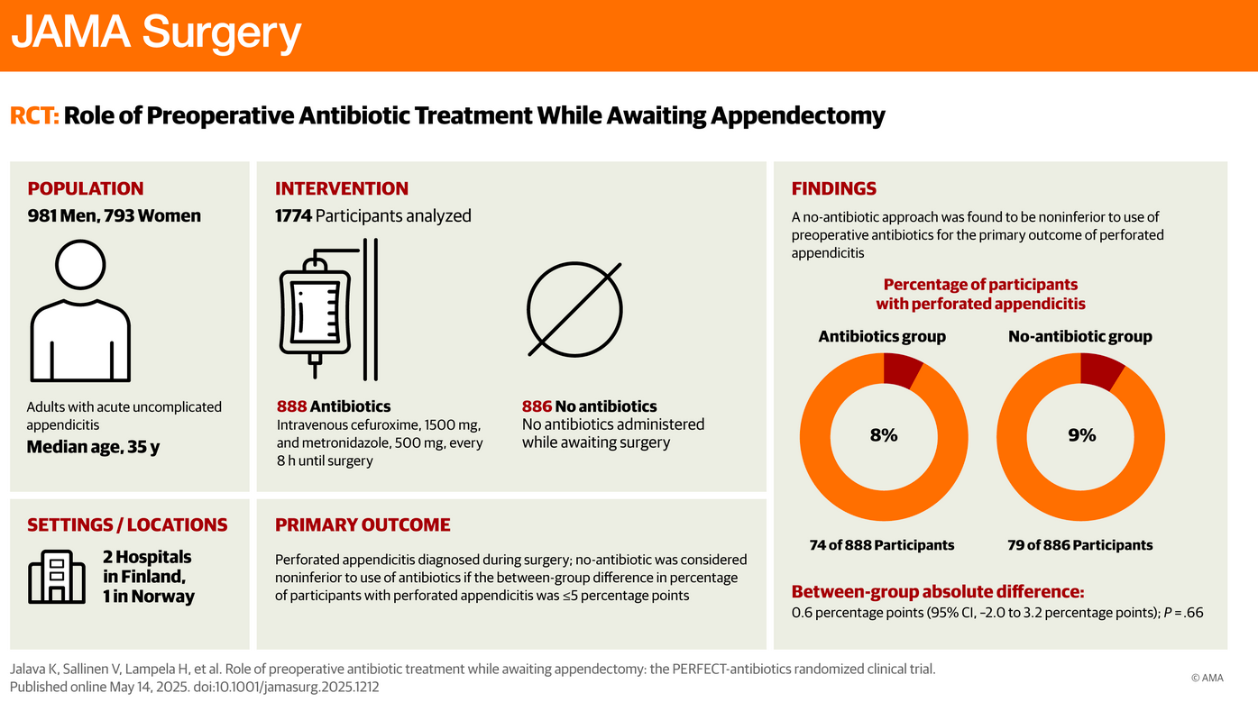

Slide 16
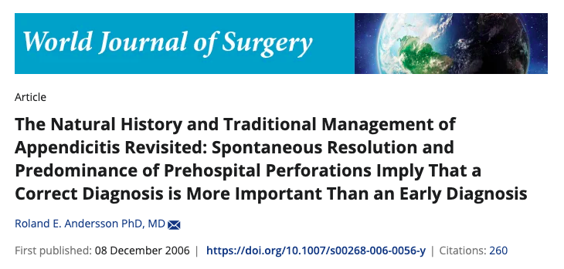

Appendicite acuta non complicata e appendicite acuta complicata
non sono un continuum, bensì due entità cliniche diverse
Instaurare una terapia antibiotica precoce non previene la perforazione
La perforazione avviene nel periodo pre-ospedalizzazione
Una diagnosi precisa (complicated vs uncomplicated) è più importante di una diagnosi veloce ma imprecisa

Slide 17


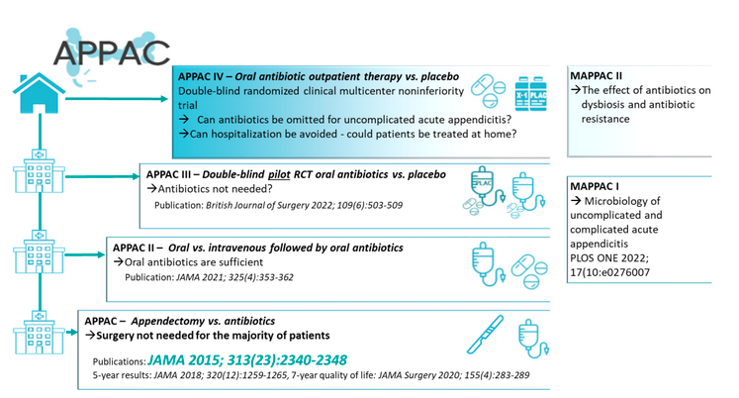

Slide 18
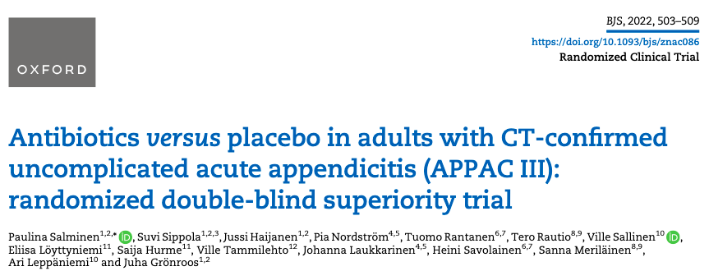
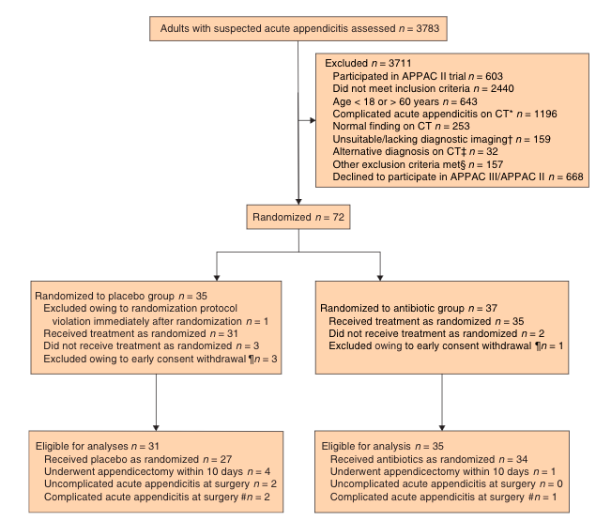
SUCCESSO (no-appendectomy) A 10 GIORNI
Placebo: 87% (96%CI 75-99)
Antibiotici: 97% (95%CI 92-100)
Limite di superiorità: 25%
Antibiotics were not statistically superior to placebo in thetreatment of uncomplicated acute appendicitis; the difference between groups in treatment success was 10 (90 per cent c.i.–0.9 to 21) per cent (P=0.142).

Slide 19
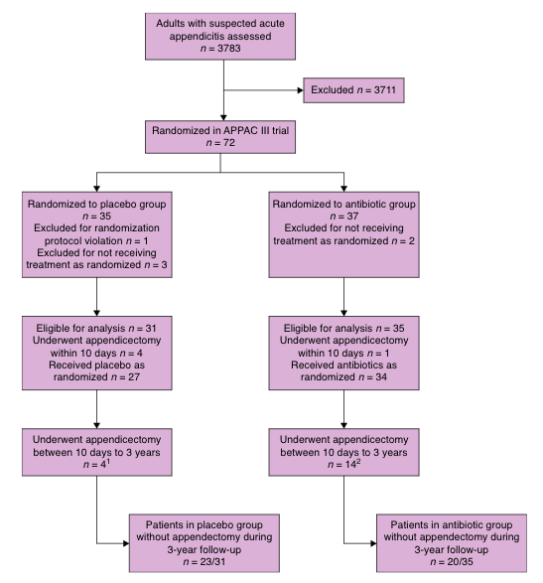
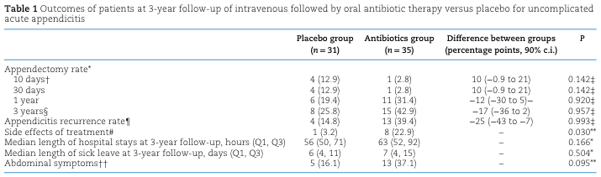

Slide 20



Slide 21
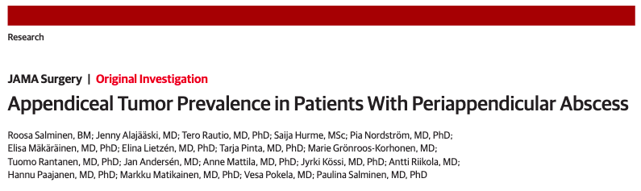
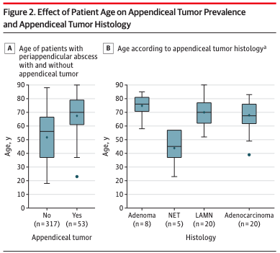
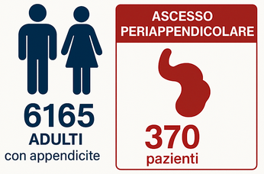
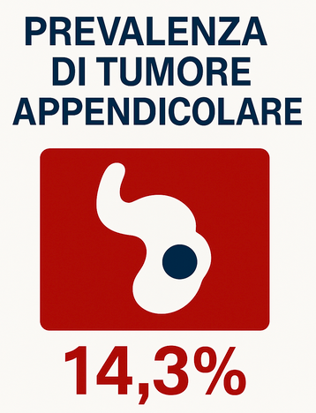
Cut-off 35 anni (AUC 0.75, 95%CI 0.68-0.82)

Slide 22
Grazie

